Slide 1

Customer success
Monthly support report
Lazar Milicevic
Key metrics, achievements, roadmap & next steps
March 2025

Slide 2
Agenda
1
Part I: Abstra support key metrics
2
Part II: Achievements & roadmap
3
Part III: Roadmap items
deep dive
4
Part IV: Product Insights
5
Part V: Next steps

Slide 3
Executive Summary
Metrics summary:
March marked another record-breaking month with 254 tickets handled, showing a +23% increase compared to February, largely driven by growth in the Research and Infrastructure squads.
The first response time was consistently under 15 minutes, surpassing all expectations and keeping the engagement rate high.
Average resolution time dropped to 3.9 hours, a 42% improvement from February, driven by better L1 ownership and efficient triaging.
CSAT held steady at 100%, confirming satisfaction despite the increased load.
Customer success: Monthly Support Report - March 2025
SageMaker Support Process - Zendesk/AWS Integration
The Zendesk–AWS integration is fully operational and scaled across support workflows.
All SageMaker blocking issues continue to be automatically routed to AWS, maintaining an average resolution time about 6 hours.
Zendesk is planned to become the central point of entry for all ticket types starting in April, aiming to reduce delays, streamline routing, and enable faster, more proactive resolution cycles.
This planned setup is expected to minimize disruptions and free up resources for strategic improvements across the support structure.
TL;DR - Most important points in one place!
Owkin K
The Owkin K Zendesk Help Center is now live, with documentation and updated onboarding flows for a new users.
All key documentation was reviewed, rewritten, and migrated to align with new support processes and workflows.
The SurveySparrow NPS tool has been fully purchased and implemented in production, allowing real-time collection of user satisfaction feedback directly from the website.
With L2 ticket handling steadily increasing, we are preparing for the April rollout of the Zendesk 3-strike rule, aiming to close stale tickets and improve follow-up efficiency.

Slide 4

Agenda
1
Part I: Abstra support key metrics
2
Part II: Achievements & roadmap
3
Part III: Roadmap items
deep dive
4
Part IV: Product Insights
5
Part V: Next steps

Slide 5
Abstra at a glance - Fullstory Metrics
Customer success: Monthly Support Report - March 2025
A general overview of numerical metrics and feature adoption compared with previous month
General Metrics
Catalog Metrics
Slide Viewer Metrics
Other Metrics
Active Users
214
+45.6%
Dataset Search
1001
-12.1%
Users
41
-18.0%
Target Directory Users
25
-3.8%
New Users
171
+3,320%
Dataset Views
2873
-18.2%
Sessions
273
-32.1%
Average session
per user
23
-36.8%
Abstra
Documentation
21
-25%

Slide 6
Key metrics overview
Customer success: Monthly Support Report - March 2025
General monthly key metrics
March was a record-breaking month with faster resolutions, higher satisfaction, and increased efficiency.
✅ 243 tickets handled – a +17.9% increase from February, showing steady growth and engagement.
⚡ 13 min first response time – 38% faster than February, ensuring even quicker visibility and triage.
⏱️ 3.5 hrs average resolution time – a 47.8% improvement, far exceeding the 24-hour standard.
🌟 100% CSAT – perfect satisfaction maintained despite rising ticket volume.
📈 92.2% of tickets resolved – up +17.9%, highlighting improved ticket handling and closure.
Key Wins:
✔️ Accelerated time-to-resolution through optimized workflows
✔️ Early steps toward the April launch of the 3-strike rule
✔️ Continuous improvement in automation and response speed
February
March
Change
Tickets Received
206
243
+17.96%
Solved/Received
78.16%
92.18%
+17.94%
Average First Response Time (Bus. hrs.)
21 min
13 min
-38.10%
Average Full Resolution Time (Bus. hrs.)
6.7 hrs
3.5 hrs
-47.76%
% Satisfied CSAT
96.3%
100%
+3.84%
*Times are in business hours.

Slide 7
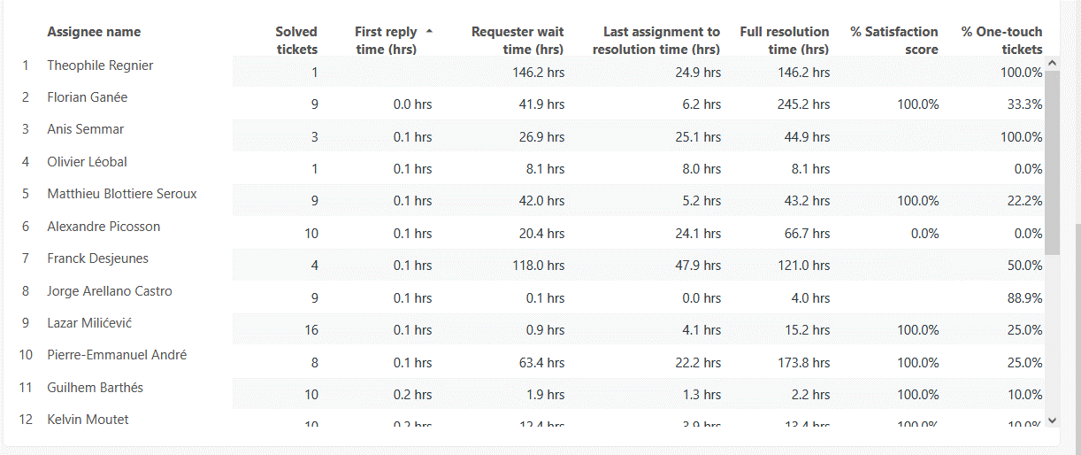
Monthly Ticket Counts & Average Resolution Times
Customer success: Monthly Support Report - March 2025
Compared with previous 3 months
2024/25
Tickets Received
Avg. Full Resolution Time
December
67
8.8 hrs
January - 2025
119
9.1 hrs
February - 2025
206
6.7 hrs
March - 2025
254
3.9 hrs
*Times are in business hours.
March Summary
✔️ 254 tickets handled (+23% from February), maintaining upward trend in engagement
✔️ First response time: 13 min – our fastest yet, enabling quicker triage and support
✔️ Avg. resolution time: 3.9 hrs – 42% improvement vs. February, exceeding SLA targets
✔️ CSAT: 100% – perfect satisfaction score despite rising ticket volume
We continue to scale successfully while improving speed, quality, and overall user experience.

Slide 8
Blocking issues key metrics overview
Customer success: Monthly Support Report - March 2025
Monthly metrics and changes for the reported blocking issues
March showed a decline in blocking issue volume, with 8 reported cases (–27% vs. February).
However, the ticket resolution rate dropped to 75%, compared to 91% in February, reflecting more complex or slower-resolving issues.
✅ First response time remained consistent at 12 minutes, sustaining fast triage standards.
⚠️ Resolution time increased by 89%, averaging 7.2 hours – indicating extended follow-up cycles.
To address this, the 3-strike rule launching in April will help close unresolved tickets faster and reduce agent workload.
The AWS-Zendesk integration remains a key enabler for routing and managing high-priority cases, with further process improvements planned to stabilize resolution performance.
February
March
Change
Tickets Received
11
8
–27.27%
Solved
10
6
−17.54%
Average First Response Time (Bus. hrs.)
0.2 hrs
0.2 hrs
0.0%
Average Full Resolution Time (Bus. hrs.)
3.8 hrs
7.2 hrs
+89.47%
*Times are in business hours.

Slide 9
Number of tickets received per topic
Customer success: Monthly Support Report - March 2025
Increasing tickets related to Dataset Creation as well as SageMaker issues.
March showed a steady stream of support requests across multiple technical areas, with SageMaker-related issues and Dataset creation requests continuing to stand out as recurring topics.
📌 The most notable trends this month include:
15 tickets related to SageMaker issues, maintaining high priority
7 tickets requesting creation of new Abstra Projects, showing increased adoption
3 tickets submitted for Dataset Creation Approval, indicating early-stage data onboarding
2 tickets for enabling CI access to CodeArtifact, reflecting growing usage of internal pipelines
Topic
Tickets
Other
17
SageMaker Issues
15
Create a new Abstra Project
7
Dataset::Dataset Creation Approval Request
3
Allowing CI to access codeartifact package registry
2
Notes:
rank by desc order

Slide 10
Trend in topics received compared with previous month
Customer success: Monthly Support Report - March 2025
Highest changes in number of tickets received per topic
February
March
Change
SageMaker Issues remained stable with 15 tickets for a second month in a row, indicating continued support needs in this area
Dataset Creation Approval requests dropped –96%, likely due to a resolution of bulk dataset creation activities in February.
CI access to CodeArtifact decreased –77.8%, suggesting stabilization in CI/CD configurations after last month's spike.
Other
12
17
+41.67%
SageMaker Issues
15
15
0.00%
Create a new Abstra Project
2
7
+250.00%
Dataset::Dataset Creation Approval Request
78
3
–96.15%
Allowing CI to access codeartifact package registry
9
2
–77.78%

Slide 11
Tickets per squad
Customer success: Monthly Support Report - March 2025
Month-over-Month (MoM) Overview for ticket counts per squad
The DataOps squad remained the most active support area, handling 88 tickets. This sustained demand reflects ongoing needs in automation, CI/CD, and deployment workflows.
The Research Platform and L1 Support squads also handled a high volume of requests, managing 72 and 65 tickets respectively, driven by deeper engagement from research users and onboarding support.
Meanwhile, the Infrastructure Platform squad managed 55 tickets, continuing to serve as a key team for AWS access, system configuration, and internal tooling support.
Overall, March’s ticket distribution highlights platform maturity and operational scaling, with growing support needs shifting toward technical infrastructure and research enablement.

Slide 12
Help Center article views - December 2024
Customer success: Monthly Support Report - March 2025
Most viewed help center articles in the month
Top articles viewed this month:
Article
Views
My workspace is not starting
7
"HOME PARTITION FULL" warning message
2
Dataset creation approval request
1
Requesting compute resource for your workspace (AWS)
1

Slide 13


🏆
Superstar of the month!
Part title
Thomas Rosnet
Handling most number of L2 tickets
Florian Ganée
For having the least first response time of 0.03
business hours

Slide 14

Agenda
1
Part I: Abstra support key metrics
2
Part II: Achievements & roadmap
3
Part III: Roadmap items
deep dive
4
Part IV: Product Insights
5
Part V: Next steps

Slide 15
Customer success roadmap timeline
Customer success: Monthly Support Report - March 2025
Main topics we aim to achieve through Q2-25.
March
April
May
Finalize the process to handle internal vs external Abstra documentation
Handling 60% of ALL tickets at L1 level
Finalizing the Owkin K documentation
Owkin K Zendesk help center
Bringing support to a new level, continuously maintaining a first response rate below 20 minutes.
Handling more l2 tickets
Zendesk – Focal point for all requests
Owkin K – Building support processes for the Owkin K users.
Owkin K – Making support infrastructure better based on early insights
Implementing Zendesk 3 strike rule
Maintain the first response time for both Abstra-related and Owkin K tickets under 20 minutes.
Handle more L2 tickets and fully take over tickets related to Owkin K, with the help of developers.
Owkin K – Continuous process improvement, support infrastructure based on feedback and work.
March Highlights:
AWS-Zendesk integration fully operational, streamlining SageMaker ticket handling.
Owkin K Zendesk Help Center live and ready!
Continued first response rate below 15 min, with 100% CSAT.
Laying the foundation for April: better follow-ups, smarter workflows, and scalable support.

Slide 16
Agenda
1
Part I: Abstra support key metrics
2
Part II: Achievements & roadmap
3
Part III: Roadmap items
deep dive
4
Part IV: Product Insights
5
Part V: Next steps

Slide 17
Customer success Q2 Roadmap items (RIs)
Customer success: Monthly Support Report - February 2025
01
Zendesk – Focal point for all support requests
02
Leverage FullStory insights to improve Owkin K support infrastructure
03
Maintain first response time under 20 minutes for both Abstra-related and Owkin K tickets

Slide 18
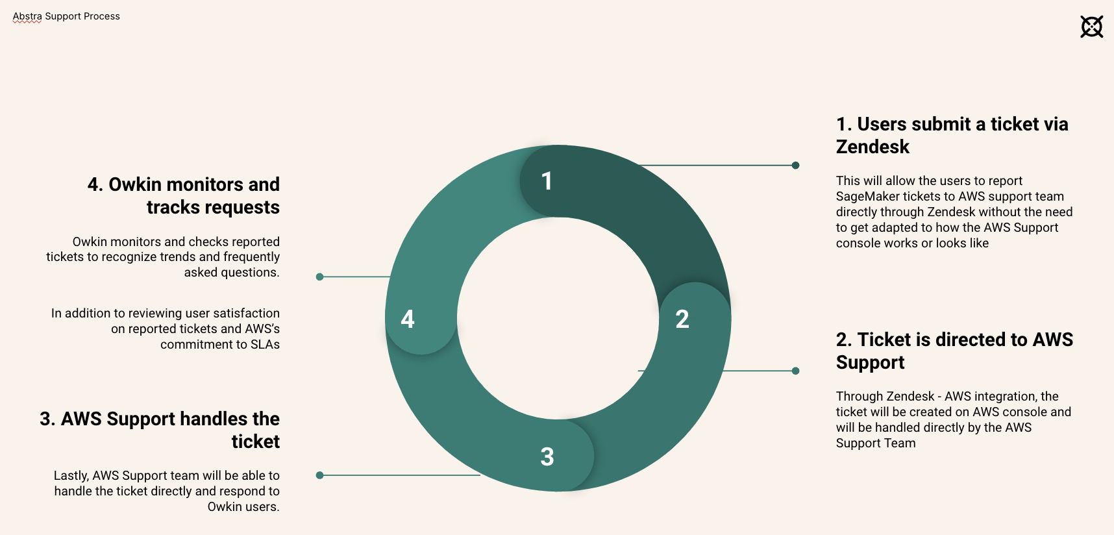
RI#1: Abstra Global Support
Process
AWS Support- Zendesk Integration
Customer success: Monthly Support Report - March 2025
🚀 Optimizing Ticket Resolution – Preparing for April Improvements
Since the integration went live, the technical setup has been performing exceptionally well. In February, a total of 15 SageMaker tickets were processed, with an impressive average full resolution time of 6.6 hours, far below the 24-hour SLA threshold.
However, we have identified a growing challenge: delayed or missing responses from Owkin users, which is beginning to affect not only SageMaker tickets but other Zendesk requests as well.
👉 Planned Solution: In April, we will introduce a "3-strike rule" within Zendesk.
The rule will automatically attempt to contact the user three times over three consecutive business days, clearly notifying them that the ticket will be closed after the third attempt if no response is received.
Expected outcomes:
Reduced number of open tickets where the issue is already resolved
Clearer visibility into active workload
Improved support team efficiency and ticket management
This enhancement marks the next step in our commitment to streamlining support and maintaining top-tier service responsiveness.
Workflow after SageMaker migration
Slide Deck

Slide 19
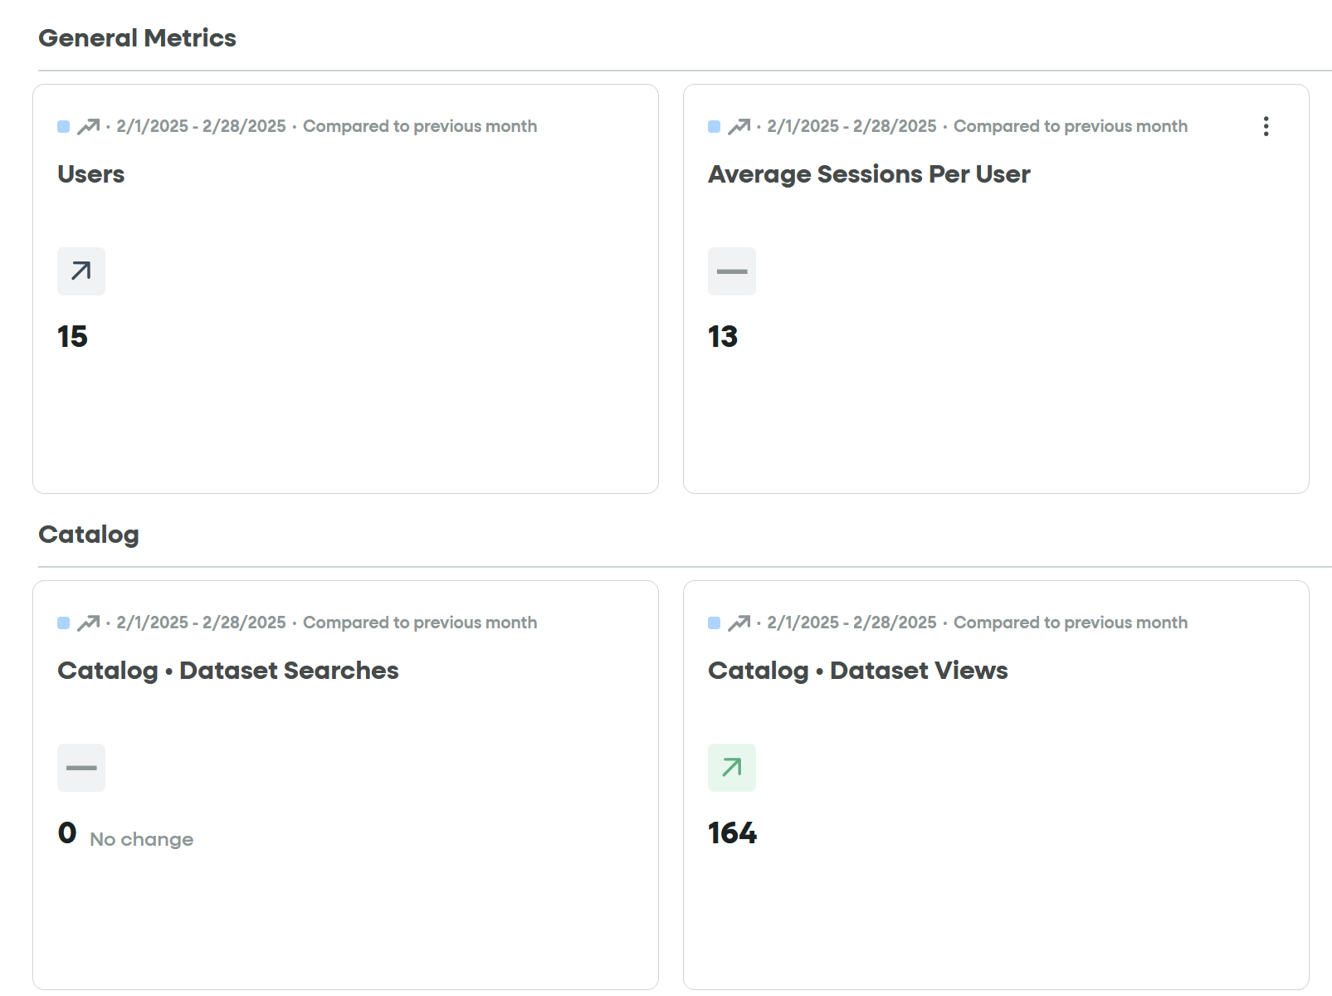
RI#2 Leverage Fullstory insights
Customer success: Monthly Support Report - March 2025
🚀 RI#2 Leverage FullStory Insights
New Visibility into Owkin K User Experience
FullStory is now fully integrated into Owkin K, allowing us to track real-time user behavior, detect friction points, and enhance onboarding based on direct interaction data.
This new level of visibility enables us to:
✅ Identify login or navigation issues early
✅ Make data-driven decisions for future improvements
✅ Enhance platform performance for a better user experience
📊 Room for Improvement:
Currently, Owkin K users are grouped together with Abstra users in FullStory, which limits the accuracy of behavior analysis.
To address this, we plan to create a dedicated dashboard that will filter and track only Owkin K users. This will ensure cleaner data and more targeted insights for optimizing future events and onboarding processes.
Fullstory – Owkin K

Slide 20
Agenda
1
Part I: Abstra support key metrics
2
Part II: Achievements & roadmap
3
Part III: Roadmap items
deep dive
4
Part IV: Product Insights
5
Part V: Next steps

Slide 21
Next steps for Customer Success
Customer success: Monthly Support Report - March 2025
Deliver excellent customer service
→ Monitor and optimize the Zendesk-AWS workflow to ensure smooth ticket routing. → Maintain first response time under 20 minutes while increasing L2 ticket resolution. → Continue improving response time and handling critical support requests efficiently.
Improving Zendesk Process Efficiency
→ Create a Zendesk 3-strike rule to automatically close tickets after 3 consecutive days without user response (launching in April)
→ Position Zendesk as the central hub for all incoming requests to ensure better tracking and ownership
→ Improve efficiency by reducing the number of open tickets where issues are already resolved
Please do not hesitate to reach out to me for any questions.
Deepen Insights from FullStory Analytics → FullStory is now fully integrated with Owkin K, enabling better visibility into user experience
→ Plan to create a dedicated FullStory dashboard that filters only Owkin K users, separating them from Abstra segments
→ Use interaction data to drive platform improvements and guide user onboarding strategy

Slide 22
Agenda
1
Part I: Abstra support key metrics
2
Part II: Achievements & roadmap
3
Part III: Roadmap items
deep dive
4
Part IV: Product Insights
5
Part V: Next steps

Slide 23
Thank you!

